Slide 1











VGLOBAL Groups

Slide 2



www.vglobal.asia
ABOUT US,
VGLOBAL
Missons & Goals
We are a New Age App Company ready to coupled with a eco system to establish more business opportunities.
Following the foot-step of the most successful business platform “Alibaba” and visonary Mr Jack Ma, VGLOBAL aims to be new rookie in app industry globally.

Slide 3
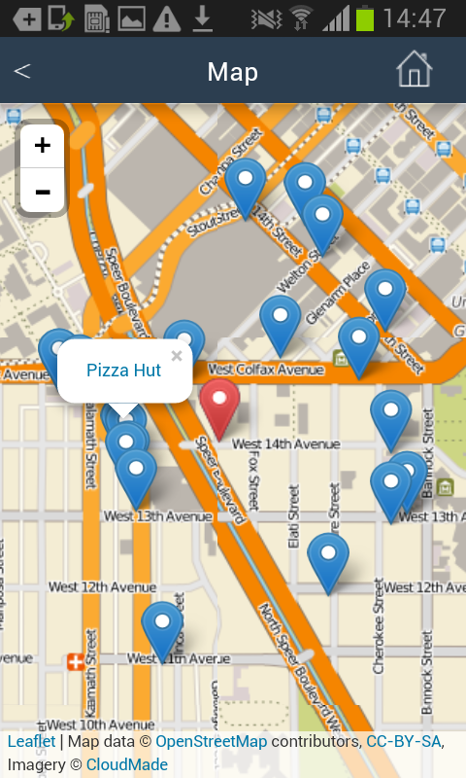

www.vnavi.asia
VNAVI app, Navigation Map
What is location-based advertising & why is it the next big thing?
66% of marketers believe location-based advertising is the ‘most exciting’ mobile opportunity for 2016, according to a recent IAB UK study I quoted in our digital marketing stats round-up.
https://econsultancy.com/blog/67418-what-is-location-based-advertising-why-is-it-the-next-big-thing/
By Jack Simpson
Expansion step 1

Slide 4
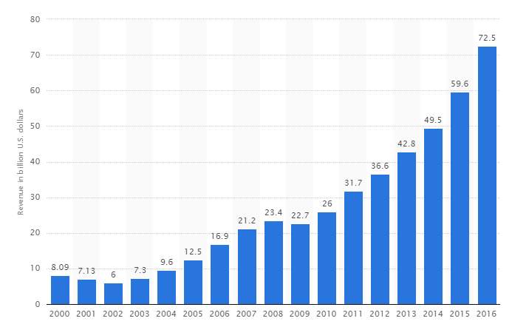
www.vnavi.asia
Location-based advertising (LBA) is a new form of advertising that integrates mobile advertising with location-based services. The technology is used to pinpoint consumers location and provide location-specific advertisements on their mobile devices.
Online advertising revenue in the United States from 2000 to 2016 (in billion U.S. dollars)
VNAVI app, Navigation Map
This basic app can naturally evolved into many other very successful businesses
Expansion step 1

Slide 5

www.vnavi.asia
VNAVI
LBA MERCHANTS PROGRAMMES
Location-based advertising (LBA) is a new form of advertising that integrates mobile advertising with location-based services. The technology is used to pinpoint consumers location and provide location-specific advertisements on their mobile devices.
Online advertising revenue in the United States from 2000 to 2016 (in billion U.S. dollars)
VNAVI app, Navigation Map
Expansion step 1

Slide 6
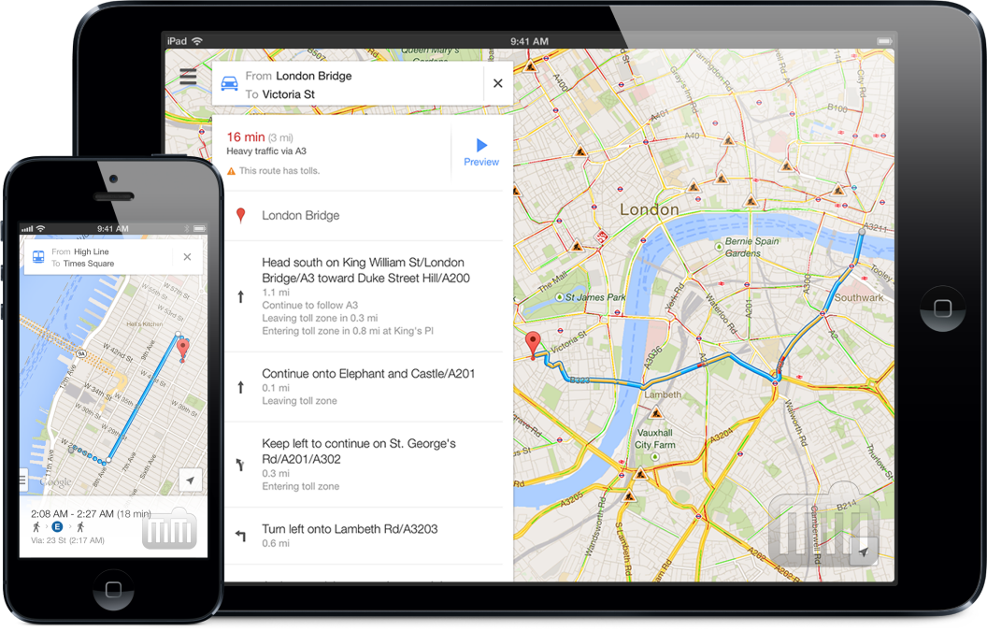
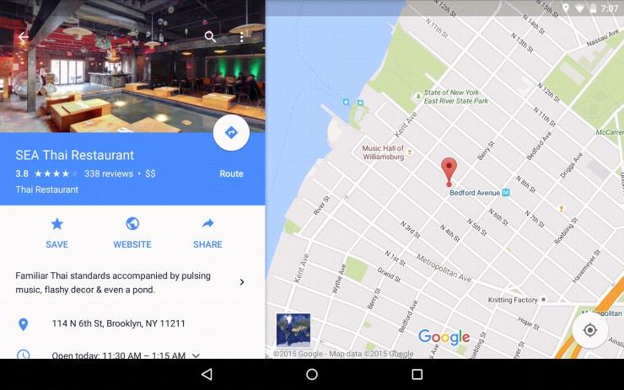

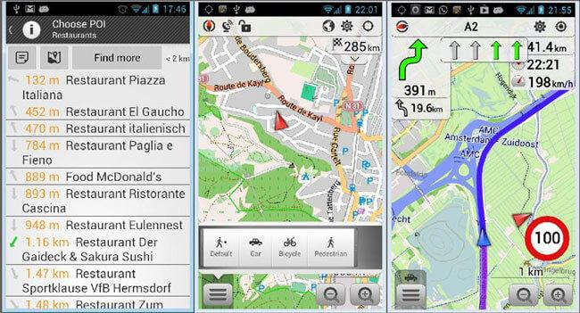
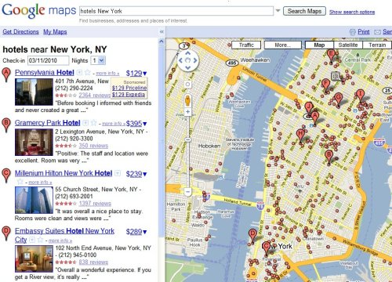
www.vnavi.asia
VNAVI
LBA MERCHANTS PROGRAMMES
Expansion step 1
VNAVI app, Navigation Map

Slide 7

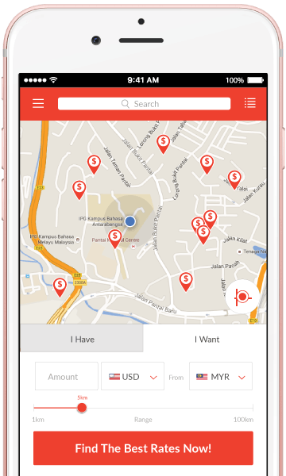
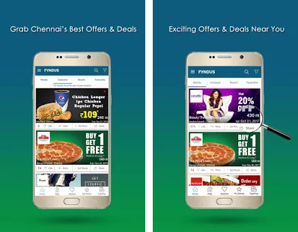
www.vnavi.asia
VNAVI
LBA MERCHANTS PROGRAMMES
EXCITING OFFERS
NEAR YOU
VNAVI app, Navigation Map
Expansion step 1

Slide 8

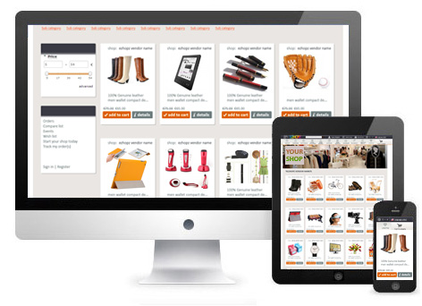
VMALLS
I Loves Shopping App
Vmalls.asia will officially start up with exciting offers near you allowing our members to shop on line. We will have a wide range of products directly imported from Korea, China and Europe.
Offering you the Most afforable,
Best Quality products.
Expected Launch date in Dec 2016 or earlier
Expansion step 2

Slide 9
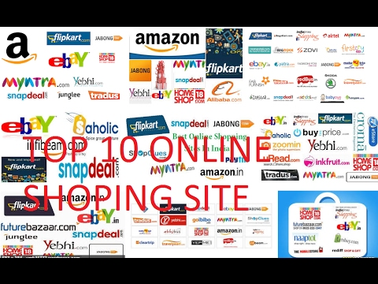
VMALLS
I Loves Shopping App
Expansion step 2

Slide 10
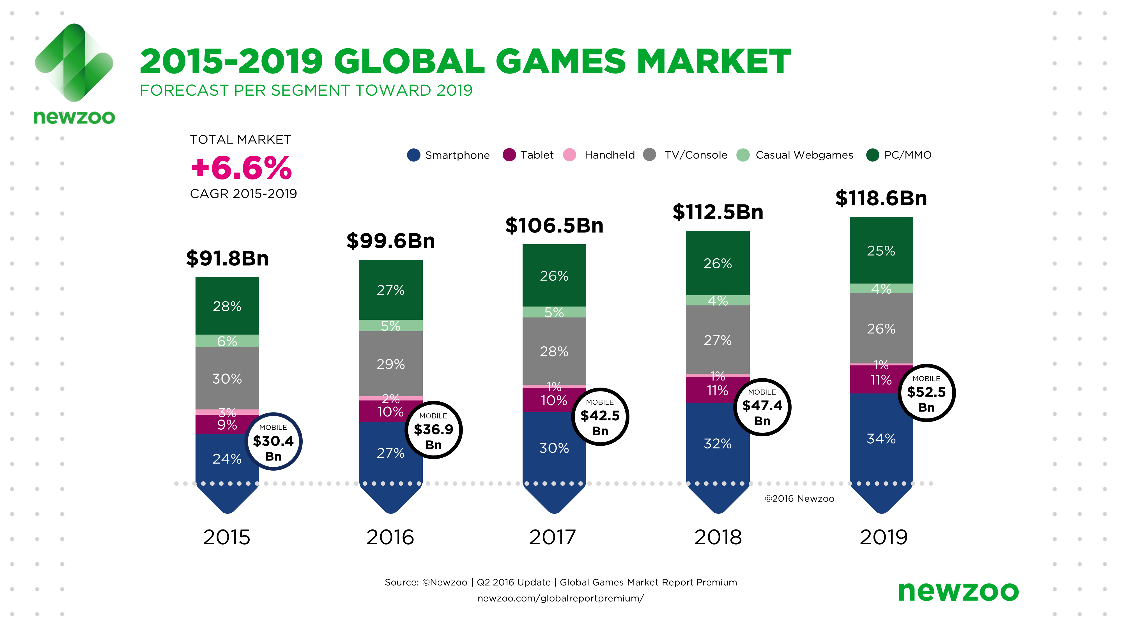
VGAMES
VR games App
VGAMES
Newzoo released the latest quarterly update of its Global Games Market Report. It shows that gamers worldwide will generate a total of $99.6 billion in revenues in 2016, up 8.5% compared to 2015. For the first time, mobile gaming will take a larger share than PC with $36.9 billion, up 21.3% globally. APAC continues to dominate worldwide, accounting for 47% of the market. China alone accounts for one-quarter of all global game revenues. Newzoo expects the global market to grow at a CAGR of +6.6% toward 2019, eventually reaching $118.6 billion with mobile gaming at $52.5 billion.
APR 21 2016
Expansion step 3

Slide 11
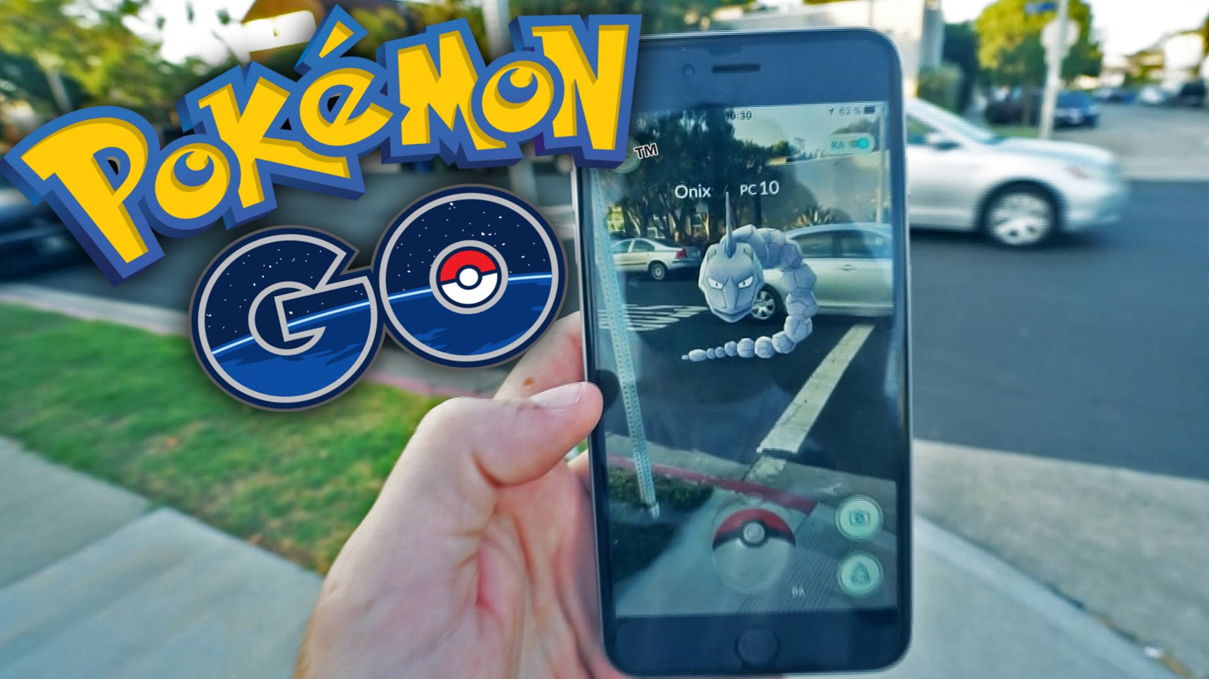

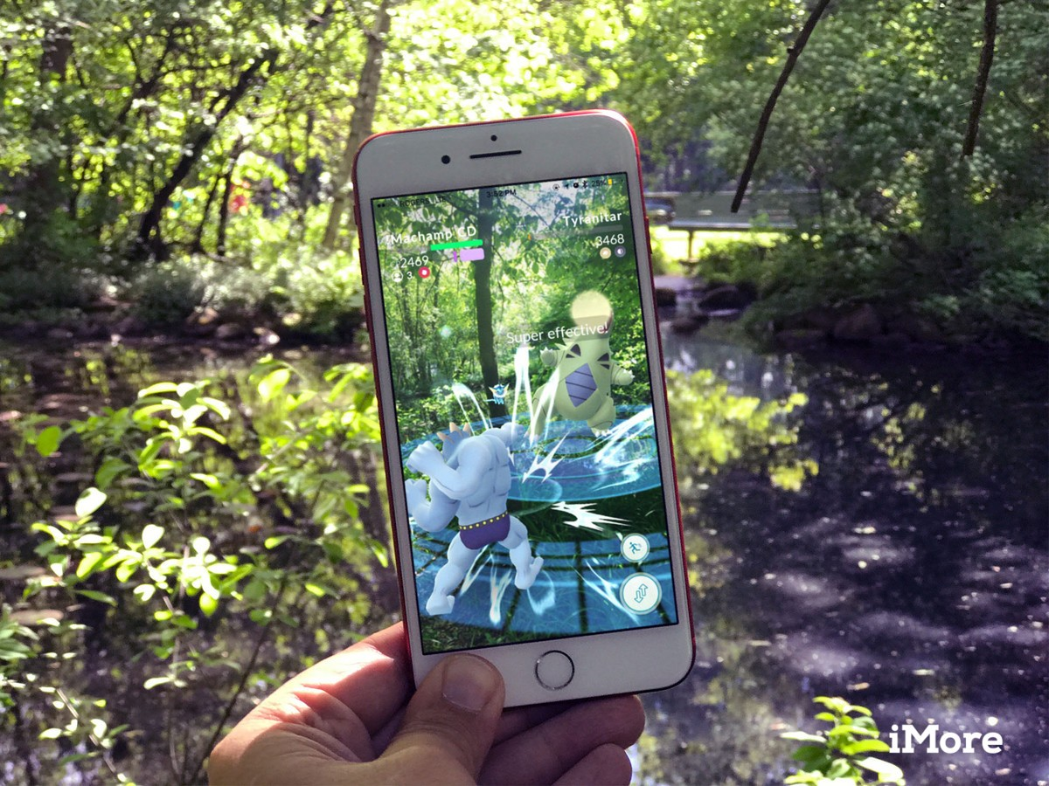

VGAMES
VR games app
FREE DOWNLOAD
Our First VR game will be similar to pokemon GO, which will be ready to launch in June 2018
Our First lucky game will be similar to jackpot, which members will stand to win more VGlobal Credits for shopping and others which will be ready to launch in Dec 2017
Expansion step 3

Slide 12
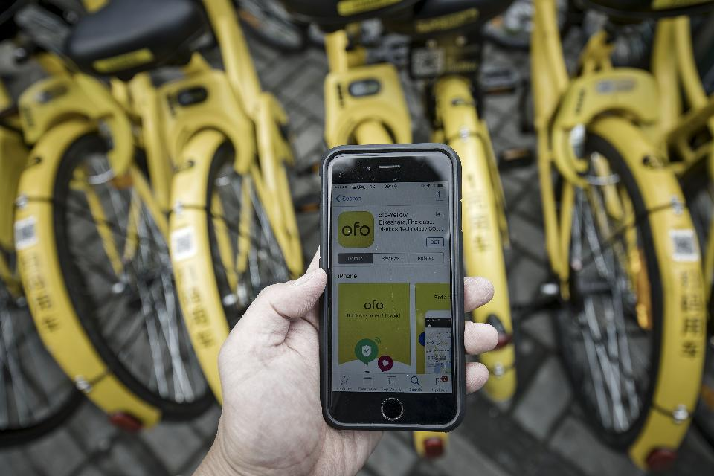
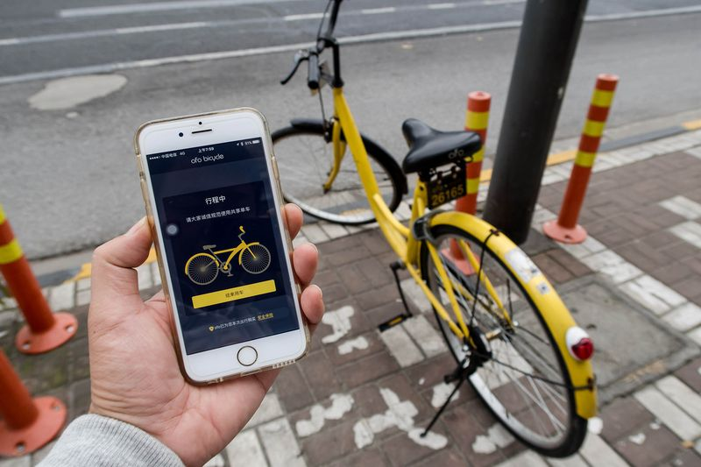
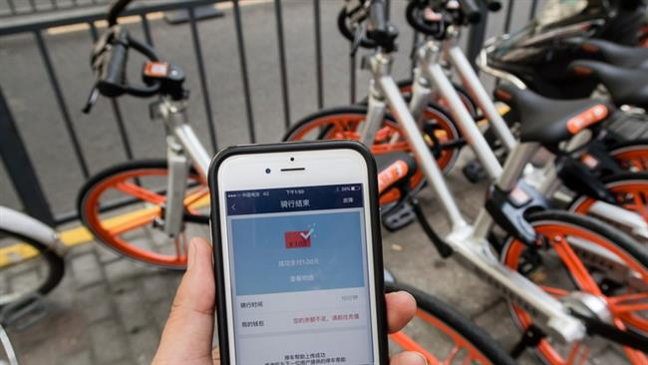
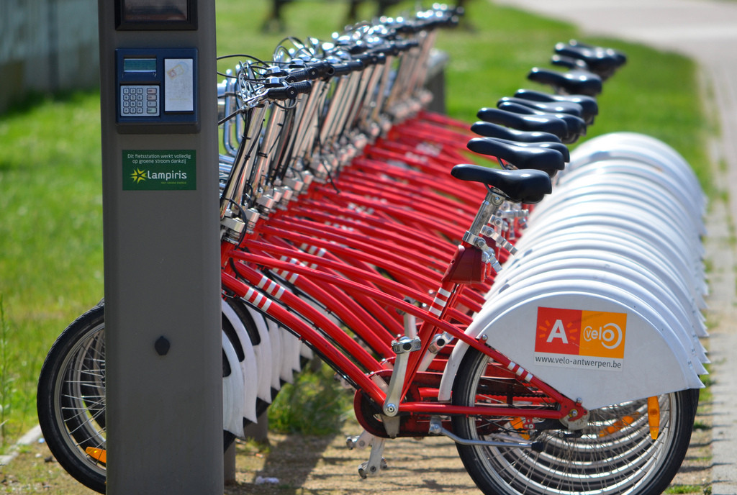
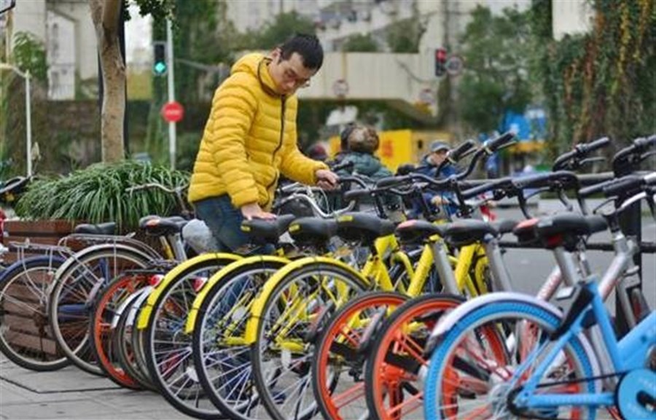
VBIKES app
SHARING PROGRAMME
VBike company will provides the latest trend in travel solution especially in heavy populated cities with short range (2-4km) travel needs.
It is a great proven success business models around the world especially when Mobikes announces 600mn investment received.
Expansion step 4

Slide 13



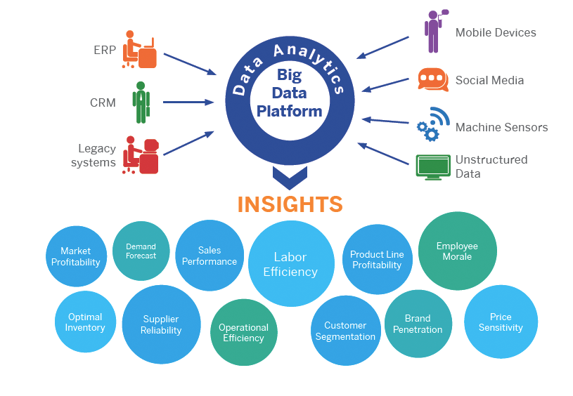
VBIKES app
SHARING PROGRAMME
China's Mobike raises $600 mn to fund bike-sharing expansion
(AFP News, 16/6/2017)
While the potential scale of these businesses has no doubt helped to attract investment to the tune of hundreds of millions of dollars,
the real selling point for these investors is gaining access to millions of tech-savvy customers. Thus, gaining the BIG DATA.
Expansion step 4

Slide 14

Bike-Sharing Grows Up: New Revenue Models Turn a Nice Idea into Good Business
AUG 22, 2011 @ 01:54 PM 16,150 2 FREE Issues of Forbes
Expansion step 4

Slide 15
VBIKES app
SHARING PROGRAMME
Focus more on Advertising! Why?
Income from advertising is 5 times higher than bike rental
To get people attracted
Ofo and Mobike are the most successful of the bike-sharing companies to date and are now valued at more than $1 billion.
To be launch in Jan 2018
With Existing Bikes, more income will be raise from advertising income
Expansion step 4

Slide 16
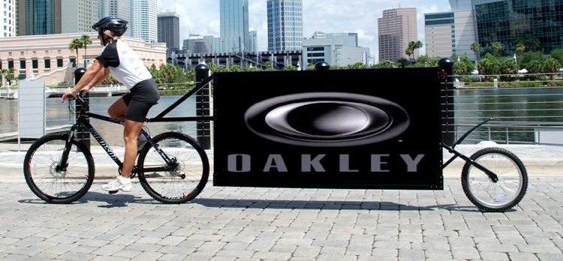
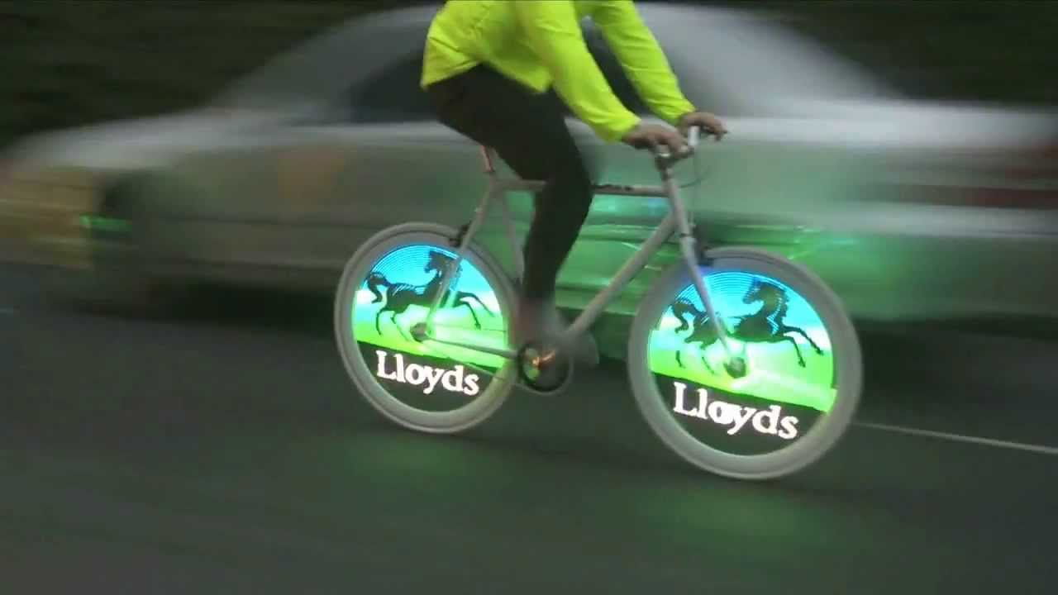
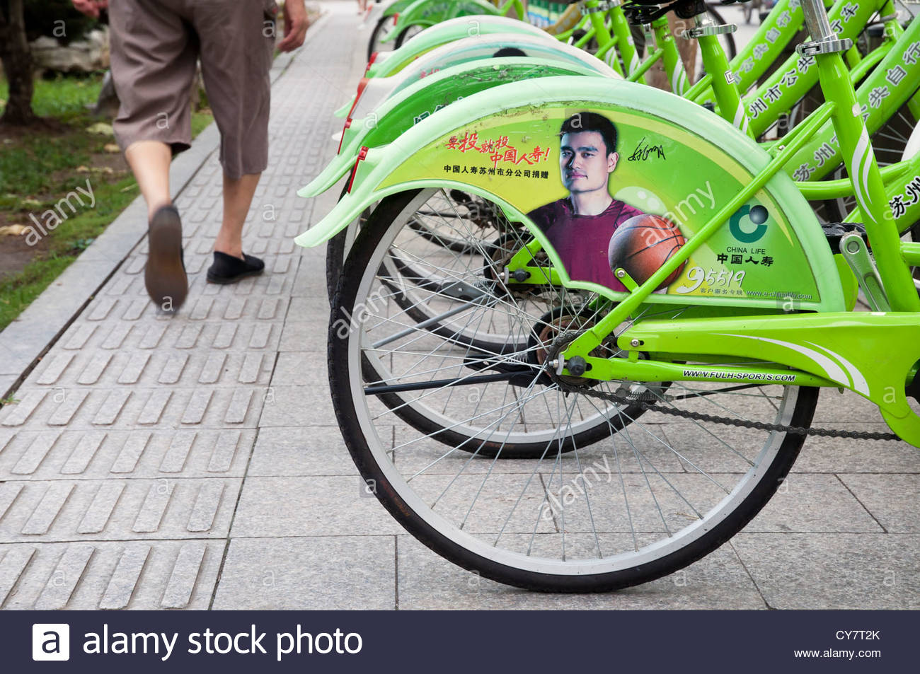
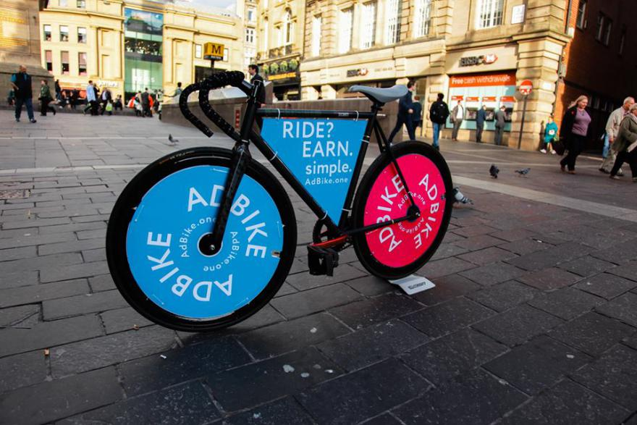
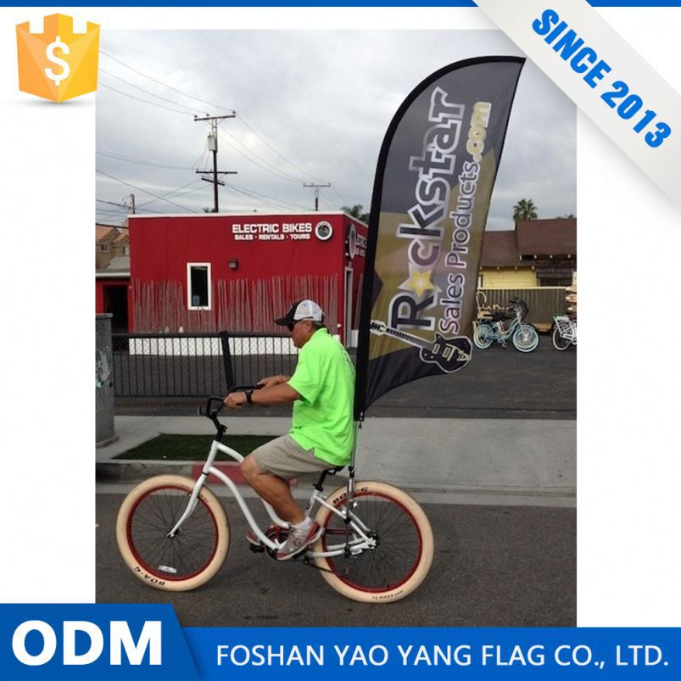
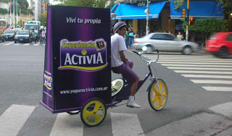
Since more revenues could be raised from advertisements on bike, the next step is to expand the business into a profitable advertising firm. VADS will be form to maximise profit for our shareholders.
Expansion step 5

Slide 17
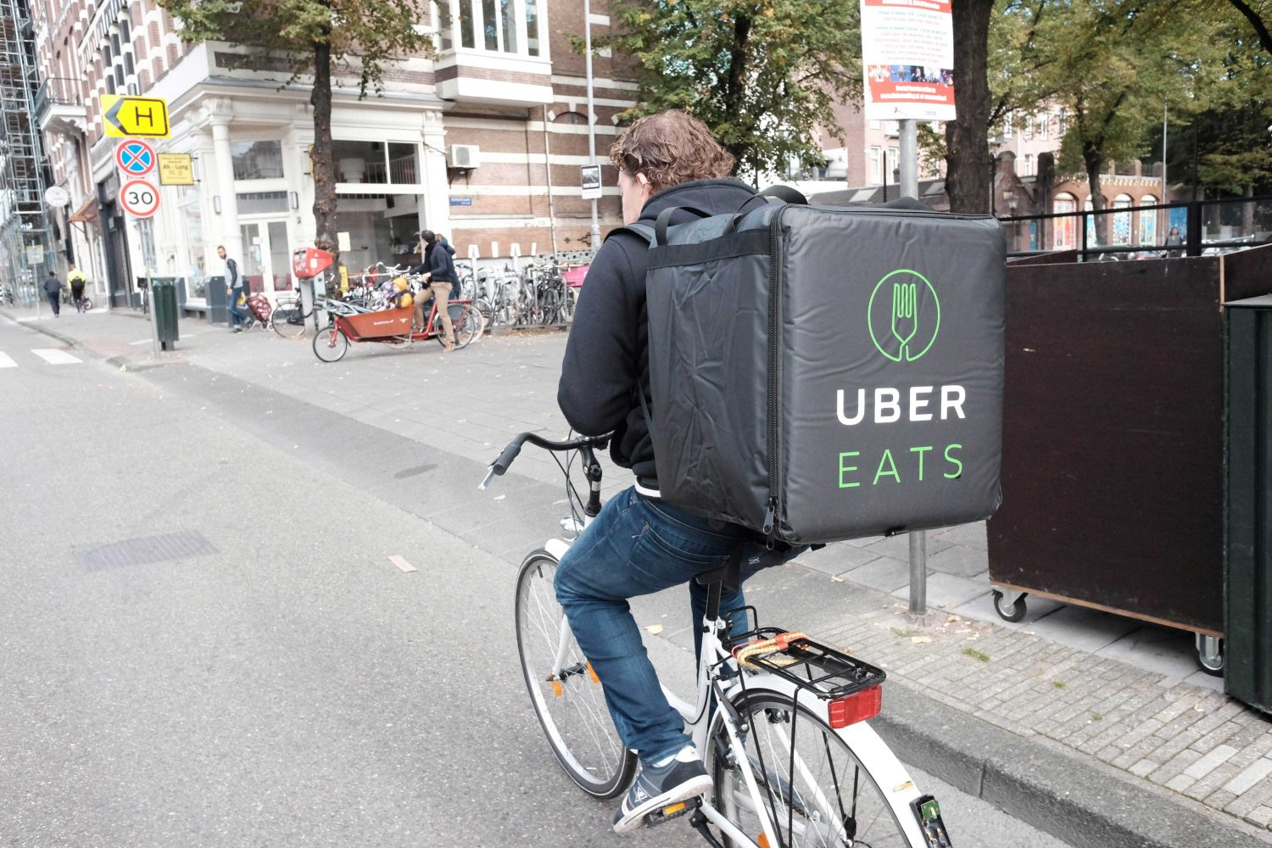
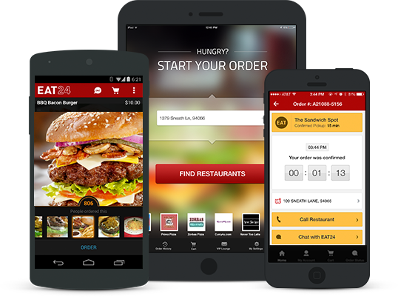

Eco Business sytems involving expansion into horizontal and vertical expansion. Naturally, the next sought after business will be setting up an app which serves the community. And its time to built an app to satify the gluttons. The VYummy app will be ready by mar 2018 or earlier
Expansion step 6

Slide 18
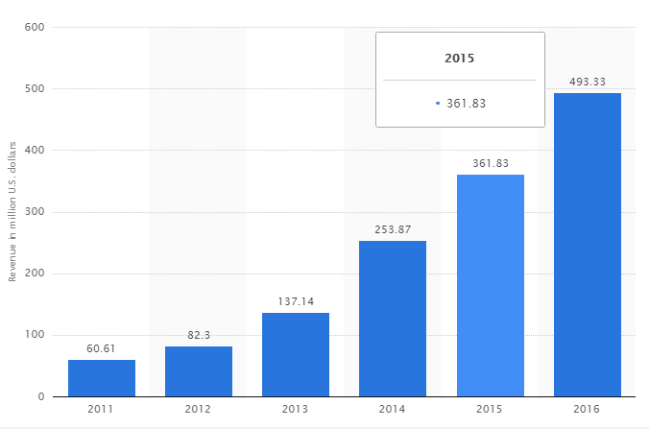
Projected profit: UberEATS: Uber for Food Delivery:
1 million download worldwide by June 2017
Revenue: Nearly $500k by June 2017
Revenue of Grubhub worldwide from 2011 to 2016 (in million U.S. dollars)
Expansion step 6

Slide 19
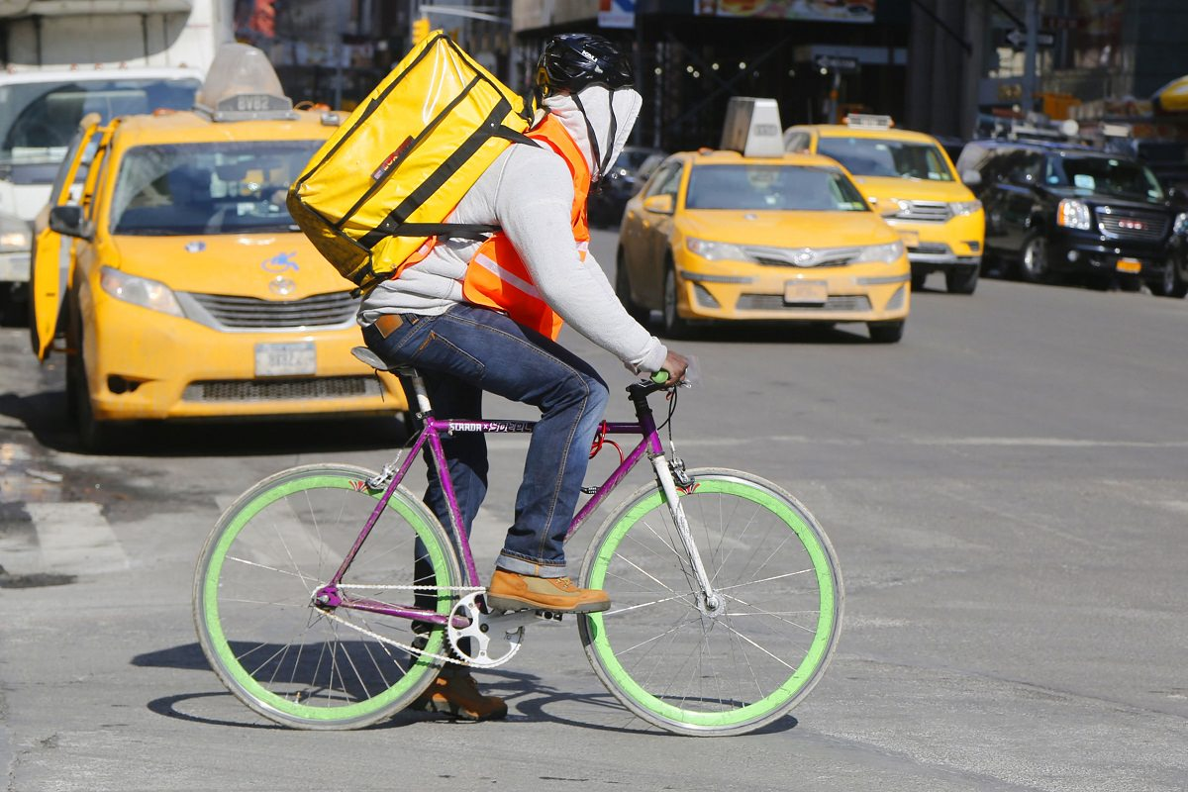
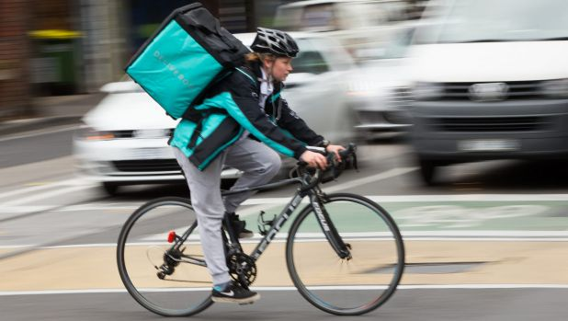

VEXPRESS app will serve more purposes when its being the next local courier service. VExpress will be ready Mar 2018 or ealier.
Expansion step 7

Slide 20
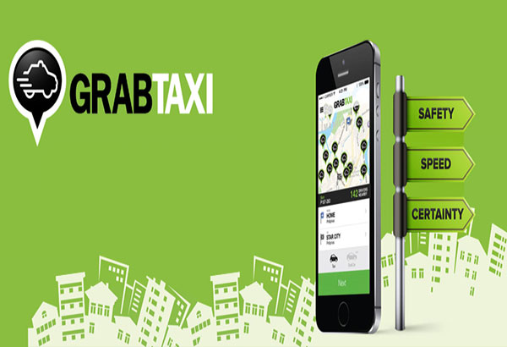
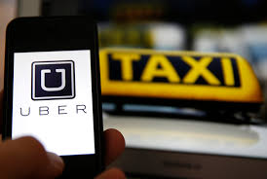
THE NEXT E-HAIL APP
Here‘s How Much Uber Made in Revenue in 2016
Ride-hailing service Uber Technologies generated $6.5 billion in revenue last year and its gross bookings doubled to $20 billion, the ride-hailing service said on Friday.
GrabTaxi raises $350M to boost SE Asia operations
Our next big step will be taking towards the next E-Hail taxi APP. Following the success of UBER and GRAB,
Our company will Fabricate a similar E-Hail App to service the community.
Expansion step 8

Slide 21

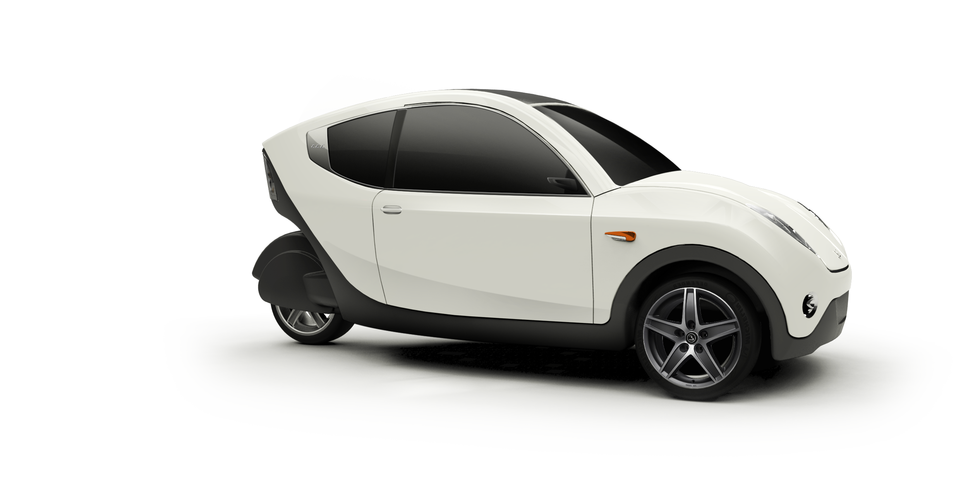



VAUTO
E-BIKE & E-CAR FACTORY
Benefits of VAuto E-bikes & E-Cars
Commuting or getting around town
Cost-saving: save money on gas
Environmental-friendly
Expansion step 9

Slide 22
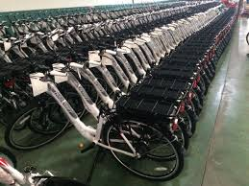
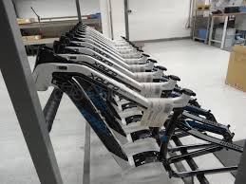
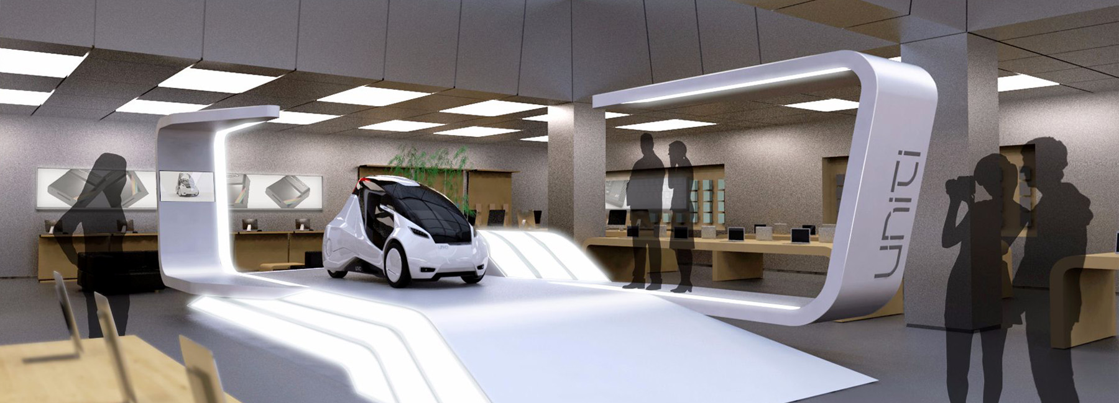
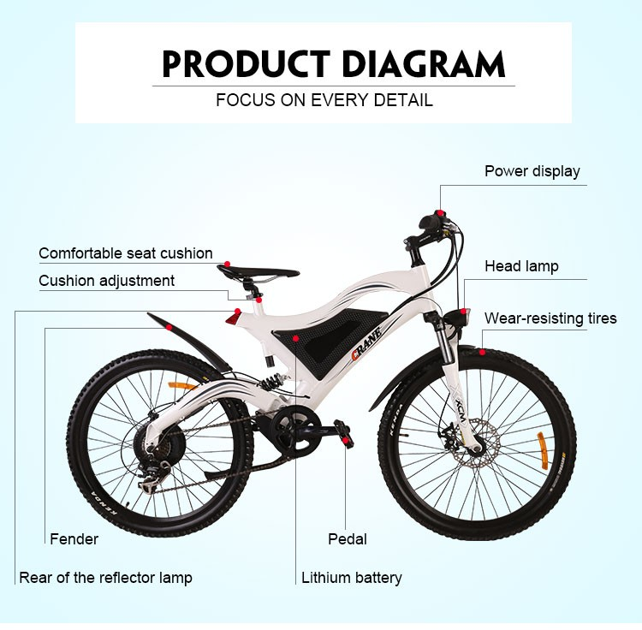
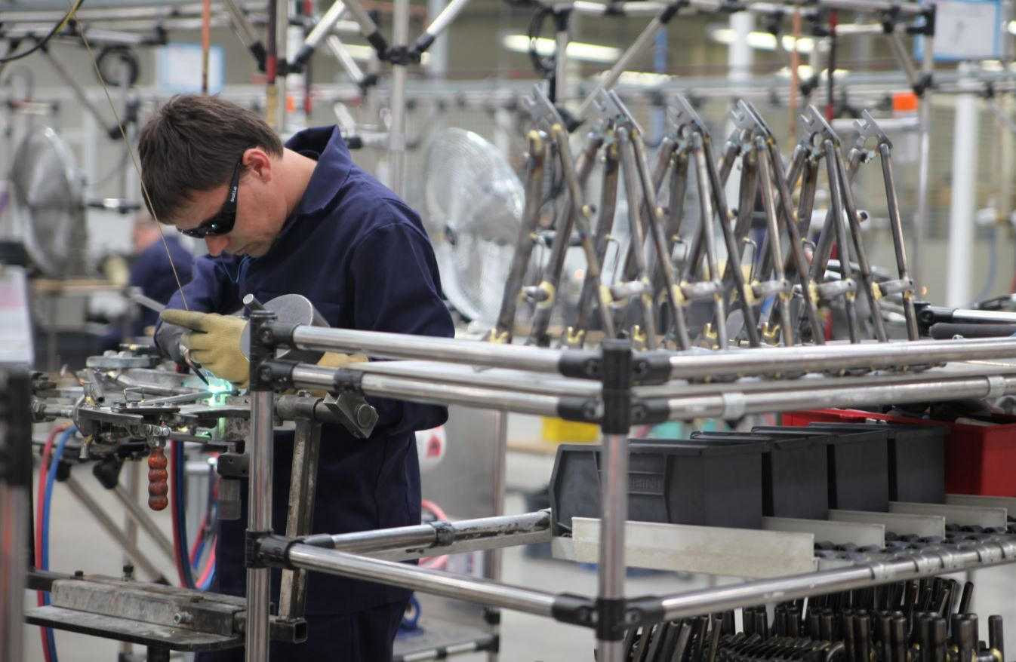
VAUTO
E-BIKE & E-CAR FACTORY
Manufacturing and Assembling of
E-Bikes and E-cars will be our next big step before launching our shares.
Expansion step 9

Slide 23


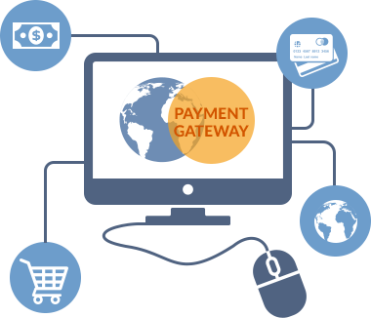

When the time is ripe, VPay Enterprise digital currency can be used to pay all our products and serices.
We will have our very own payment gateway similar to the following esteemed companies.
Expansion step 10

Slide 24




By 2019, we should be ready to launch our first group of shares to all our shareholders. And its possible cause, by then, we should have already a big pool of consumers and merchants. Not just that, it would also mean having a substantial amount of assets and capbilities.
Expansion step 11

Slide 25

VConnect
Coming Soon

